Slide 1
AERSOLUTIONS CONSULTING
MINI-SPRINT -CUSTOMER DISCOVERY AS A SALESFORCE CONSULTANT
AISHWARYA BVN
TEAM 25

Slide 2
AGENDA
Meeting Objectives:
Client - Delta Airlines
Leverage AI and CRM Solutions
Develop comprehensive insights
Implement 5-year business strategy
Address Market Dynamics
Meet Regulatory Requirements
Maintain Competitiveness
Ongoing Market Challenges
Discussion on how Delta Airlines is facing difficulties with Low Cost Carriers and Emerging Compliance Pressures.
Current Salesforce Implementation Review
Understanding the current salesforce Application with a focus on basic CRM functionalities
Discussion on why - Lack of integration with other customer service platforms and limited automation
Data Management and Security Concerns
Understanding how Delta is addressing customer issues admist the data is siloed
How Delta is coming up with a robust business strategy after recent security incidents
Future Goals and Strategic Vision
Understanding on how leveraging CRM +AI solutions support Delta’s long term goals
Discussion on Delta’s 5 year Strategy goals to be competitive and withstand future challenges in the market.
Next Steps and Follow up Actions.

Slide 3
Second Interview: Tactical Stakeholder
ALEX KIM
First Interview: Senior Stakeholder
JORDAN BLAKE
How’s your journey at Delta and what excites you about Delta Airlines?
How is Delta handling the growing competition from low-cost airlines and high regulatory pressures?
What are the key challenges you face with the current Salesforce setup, especially with its limited integration with other customer service platforms?
Can you describe your existing business processes related to customer relationship management?
What are the primary business objectives you aim to achieve through the adoption of CRM + AI solutions over the next five years?
What strategies is Delta implementing to enhance customer loyalty, and how do you believe the CRM system can support these initiatives?
Following the recent security incidents, what security measures have been implemented to safeguard customer data, especially across different platforms?
How is Delta currently addressing the challenges of siloed data, and what impact does this have on resolving customer service issues
In what areas do you think Delta could benefit from increased automation within Salesforce, such as notifications, case management, or issue tracking?
Can you describe your current security protocols in place to protect sensitive data during technology integrations
Delta’s existing infrastructure might not be ready to support large-scale AI and CRM deployments. What’s your opinion?
What types of datasets are currently utilized for customer insights and decision-making?

Slide 4
INTERVIEW APPROACH
TONE AND RELATIONSHIP
Approach the interview with positivity and openness
Be ready to listen actively and adapt to Stakeholder Communication Style.
Maintain curiosity and a willingness to understand their perspective
Prefer direct communication initially; adapt if the stakeholder leans towards indirect.
Focus of the Interview
Meeting Purpose:
Gain insights into Delta Airlines' CRM challenges and 5- year broad business strategic goals.
Desired Outcomes:
Understand the stakeholder's perspective on current operations.
Identify existing processes and areas for improvement with AI+CRM .
Send a brief email to the stakeholder that includes:
The agenda for the interview.
Key objectives of the discussion.

Slide 5
DELTA AIRLINES CURRENT PAIN POINTS
Lack of System Integration: The current systems don’t communicate with each other efficiently,
causing manual work and leading to isolated data that can’t be shared across departments
Missing Real-Time Data: Without immediate access to customer insights, it’s difficult to deliver personalized services, impacting customer satisfaction.
Limited Personalization: The lack of unified systems means that marketing efforts aren’t customized to individual customer preferences, reducing the effectiveness of campaigns.
Efficiency vs. Cost Management: While trying to improve services, Delta struggles to manage operational costs, creating a challenge in balancing efficiency and budget.
Increased Demand for Sustainability: Customers are increasingly expecting Delta to engage in sustainable practices, making it important to focus on eco-friendly initiatives in customer engagement.
.

Slide 6
Data Quality Issues: Inconsistent or inaccurate data hampers decision-making and customer service. Without high-quality data, Delta cannot fully leverage insights to improve operations or personalize services. Duplicate or incomplete data also leads to inefficiencies and errors.
Missing Feedback Loops: The absence of effective feedback mechanisms prevents Delta from gaining valuable insights into customer experiences and internal operations. Without real-time feedback, it becomes difficult to address customer pain points, optimize services, or make timely improvements.
Ineffective Self-Service Portal: The current self-service portal lacks user-friendliness and functionality, making it difficult for customers to resolve issues on their own. This leads to increased dependency on customer service agents, longer wait times, and decreased customer satisfaction.

Slide 7
SOLUTIONS
Lack of System Integration:
Implement a centralized platform (e.g., Salesforce) to integrate systems and streamline processes.
Use data migration tools to eliminate silos and ensure smooth data flow between departments.
Showcase any business process automation or integration workflows you've developed
Missing Real-Time Data
Set up real-time data analytics dashboards using Salesforce or Power BI.
Use AI-driven insights to provide personalized customer interactions based on real-time data.
Demonstrate examples from any dashboards or data analytics models you've worked on.
Limited Personalization:
Use a unified customer view to align marketing strategies with customer data.
Implement customized marketing automation using CRM platforms like Salesforce, allowing campaigns
to be more personalized.
Include examples of marketing automation tasks you've completed in Salesforce or Flow.
Efficiency vs. Cost Management:
Implement automated workflows to reduce manual interventions and improve efficiency.
Use cost-tracking dashboards for real-time expense management
Increased Demand for Sustainability
Integrate sustainability-focused KPIs into the customer journey and engagement strategies.
Propose the use of green technologies and digital solutions that reduce environmental impact.

Slide 8
Improving Data Quality
Data Governance: Implement rules to ensure accurate, consistent data across systems.
Integration Platforms: Use centralized platforms like Salesforce to unify data.
AI-Driven Cleaning: Automate data cleansing to improve quality at scale.
Establishing Feedback Loops
Automated Surveys: Gather real-time feedback through integrated surveys.
Feedback Management: Use tools to centralize and analyze feedback from all channels.
Closed-Loop Feedback: Ensure customer feedback directly informs improvements and action plans.
Enhancing Self-Service Portal
User-Centric Design: Redesign the portal to be more intuitive and user-friendly.
Knowledge Base: Provide clear, searchable solutions for common issues.
Automation & Chatbots: Implement AI-powered chatbots for instant customer support.

Slide 9
Automation Assessment for Customer Efficiency
Identify Customer Interactions:
Map out key customer touchpoints (e.g., inquiries, bookings, support requests).
Analyze the flow of these interactions to identify areas that are time-consuming or prone to errors.
Evaluate Current Processes:
Review how customer service is currently handled (phone, email, chat).
Identify repetitive tasks, such as responding to FAQs, data entry for bookings, or ticketing processes that could be automated.
Automate Customer Support:
Chatbots: Implement AI-driven chatbots for instant responses to common queries and issues, reducing wait times and enhancing customer satisfaction.
Self-Service Portals: Enhance self-service options for customers to manage bookings, access information, and resolve issues independently.
Integrate Communication Channels:
Use omnichannel solutions to unify customer communications across platforms (e.g., email, chat, social media) for a seamless experience.
Ensure customer data is accessible in real time, enabling service agents to provide personalized assistance.

Slide 10
Automate Follow-Up Processes:
Set up automated follow-up emails or messages after customer interactions to gather feedback and provide additional assistance or information.
Implement automated reminders for appointments, flight changes, or special offers based on customer preferences.
Utilize Data Analytics:
Use analytics tools to monitor customer interactions and identify trends or pain points.
Automate reporting processes to generate insights on customer behavior, satisfaction, and service efficiency.
Measure Impact and Optimize:
Establish KPIs (Key Performance Indicators) to measure improvements in customer response times, satisfaction scores, and overall service efficiency.
Continuously assess and refine automation solutions based on customer feedback and performance metrics.
Benefits of Automation for Customer Efficiency
Faster Response Times: Automated responses to common inquiries improve service speed.
Increased Customer Satisfaction: Self-service options empower customers, leading to higher satisfaction rates.
Reduced Workload for Staff: Automation frees up customer service agents to focus on complex issues that require human intervention.
Enhanced Personalization: Unified data allows for tailored customer experiences and interactions.

Slide 11
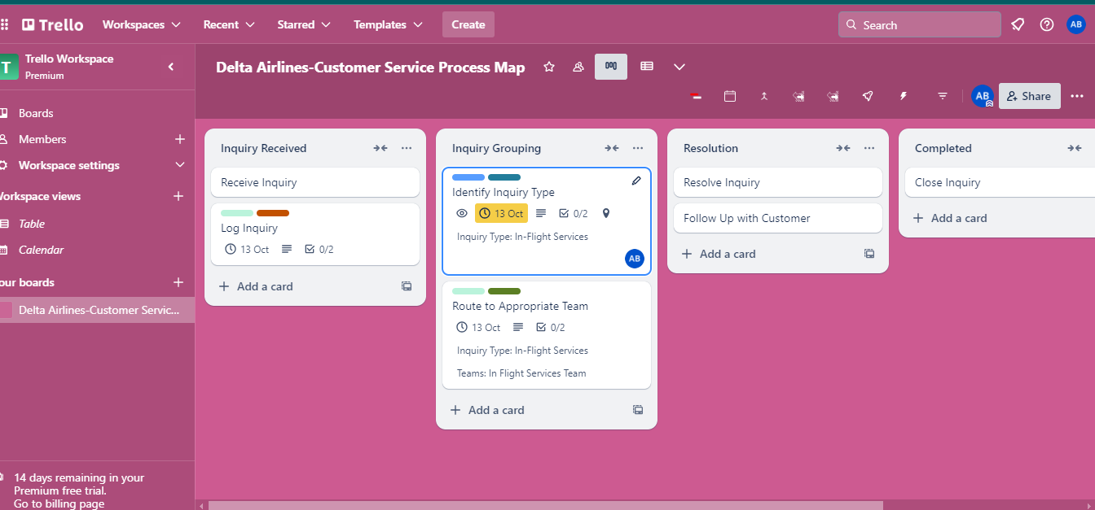
Customer Services process Map Tool used: Trello

Slide 12
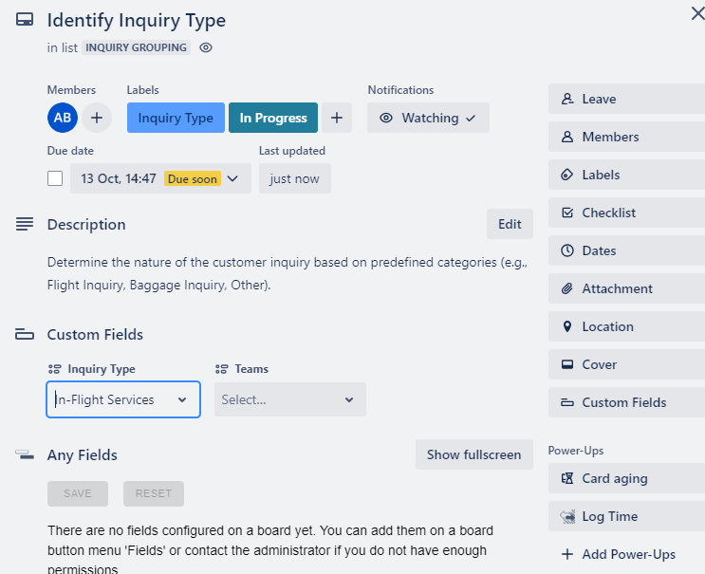
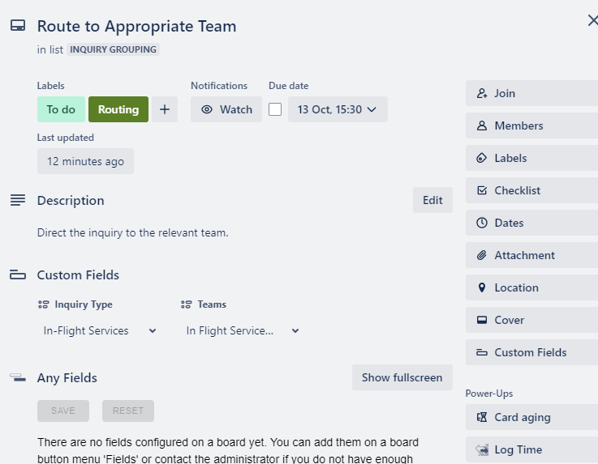
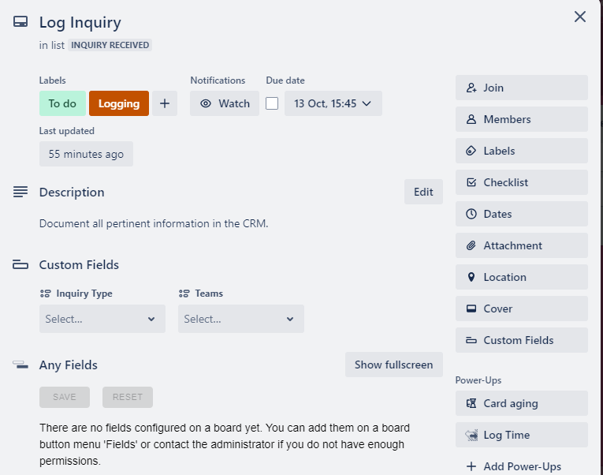

Slide 13
THANK YOU

